Slide 1
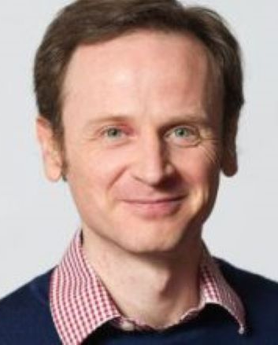
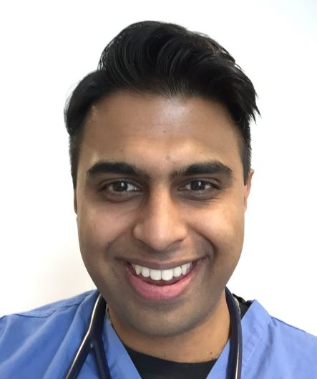
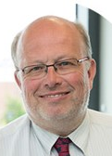
August 2023
Welcome to the
OPERA Trial Newsletter
Trial Team
Chief Investigator:
Prof Dave Jones OBE
Senior Trial Manager:
Sarah Dunn
Trial Managers:
Ciara Kennedy
Lys Evans
Trial Team
Data Managers:
Chris Weetman
Rebecca Wafer
Trial Administrator:
Alison Liddle
George Mells
Palak Trivedi
Dave Jones
Welcome from our CI & Co-Apps
Welcome to the first edition of the OPERA UK Newsletter. We thought we would just drop you all a note to say that we are approaching the opening of OPERA. It has been quite a journey to get to this point (the delays have not been to do with the trial itself but in relation to MHRA process). We do, however, now have all the approvals in place. We are very grateful for all the input from the centres around the SIV planning. Can we also just ask for your help in making sure that the OPERA teams get all the necessary documentation back ASAP.
George, Palak and I will be at the upcoming BASL immune disease SIG meeting and also the main BASL meeting and it will be good to catch up https://www.basl.org.uk/. We are also planning regular web catch up meetings.
In terms of the trials concept itself many of you will be aware of the emerging data about the importance of targeting normalisation of blood tests in PBC, and the move to earlier, better therapy. This new knowledge very much supports the OPERA trial concept. Companies are looking at better primary therapy as an approach to PBC. We will be reporting our data before they start, however, so we are ahead of the curve.
Thanks as always for all your support with this,
Dave, George and Palak
Sealed Envelope:
https://www.sealedenvelope.com/access/
Newcastle Clinical Trials Unit Contact:
opera@newcastle.ac.uk
Please ensure to use the correct email address when sending trial documentation:
SAE reporting:
nctu.opera.sae@nhs.net
Eligibility checklists and Consent Forms:
nctu.opera.conf@nhs.net
Socials:
https://twitter.com/NCLctu
https://twitter.com/UKPBC_Project
Websites:
OPERA Trial Website
Newcastle CTU, UK-PBC, PBC Foundation
10077 – OPERA – Newsletter 1 – 2023-08-16

Slide 2
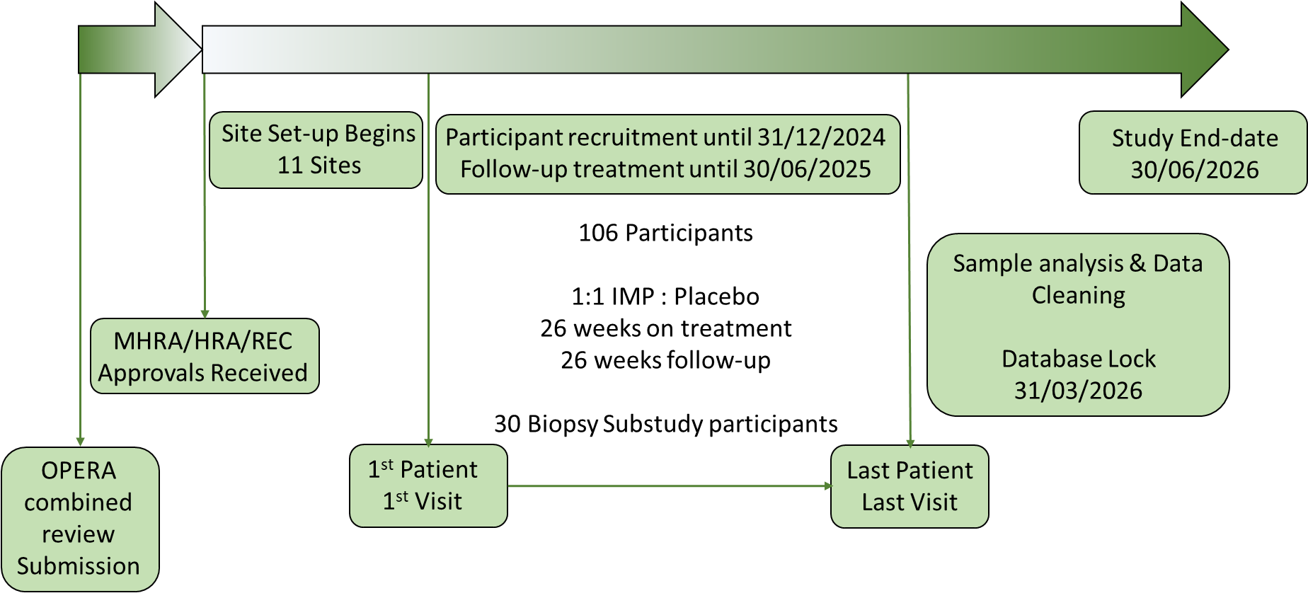
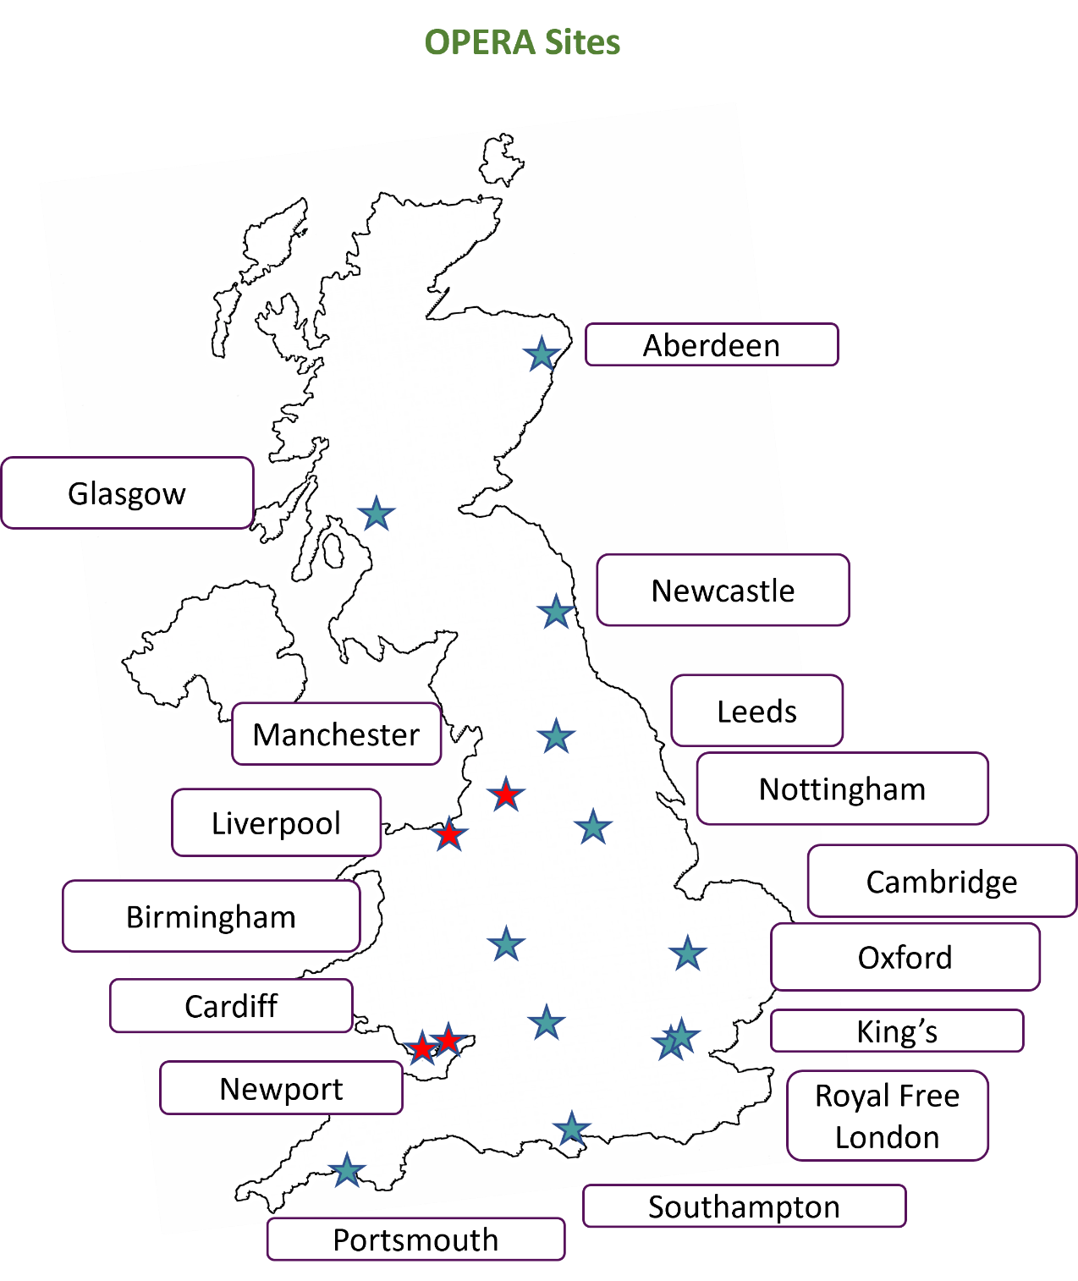
August 2023
OPERA TIMELINE
Site Set-up News
Our first sites to complete their SIVs are:
Newcastle,
Cambridge,
Glasgow,
Portsmouth
In set-up we have:
Aberdeen,
Leeds,
Nottingham,
Oxford,
King’s,
Royal Free London
We have expressions of interest from:
Cardiff,
Liverpool
Norfolk & Norwich
Where can I find the OPERA training videos? OPERA training videos are available on the invite-only TEAMS channel: OPERA Sites Group. Email opera@newcastle.ac.uk for your invitation.
What will my site Recruitment Target be? 10-12 per site.
How often will samples be sent from sites? We anticipate that samples will be batch sent to Newcastle Biobank twice per site depending on recruitment.
Is it possible to combine the Screening and Baseline blood samples to prevent multiple blood draws for participants? This is possible only in circumstances where the participant has no choice but to attend hospital for screening and baseline assessments within a short time frame.
Can participants be randomised prior to baseline? Yes, a participant can be randomised prior to the baseline visit, once they have given informed consent, all screening activity has been completed and the participant has been deemed eligible by the PI or other medically qualified and delegated personnel at site
10077 – OPERA – Newsletter 1 – 2023-08-16

